Slide 1
Linear Variable Differential Transformer
By,
Vedant Bhoj
Faizan Bute
Harsh Chaturvedi
LVDT
Notes:
Stereo Amplifier

Slide 2
Introduction
Objective
  To build a compact stereo amplifier for different controls like bass, treble and volume.
Outcome
  This stereo amplifier runs from a 16V 1.25A supply and has inputs for three stereo program sources such as MP3 player, CD player and FM/AM tuner and has front-panel LEDs to indicate which source has been selected. The other controls are Bass, Treble, Volume and Balance.
LVDT
Notes:
Stereo Amplifier

Slide 3
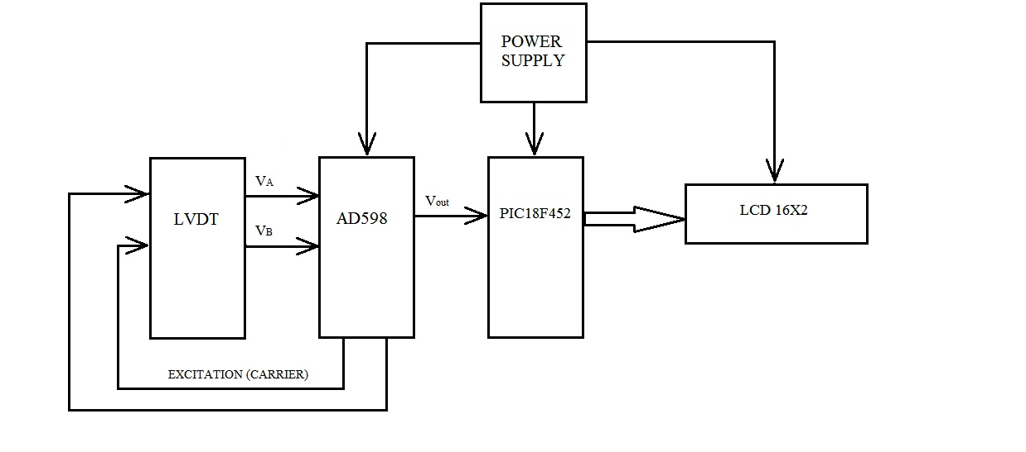
Block Diagram
LVDT

Slide 4
Block Diagram Description:
a) Source selector:
Source selector switch TPTT allows the user to select input signals from any one of three sources. These are labelled CD, MP3, and TUNER, but any of these inputs can be used for line level audio signals from sources such as a DVD player, a Mini Disc player, games console.
b) Input Preamplifier:
From the switch, the selected signal passes through a simple low-pass filter. This filters out any RF signals or noise that may be present with the incoming audio signals, to prevent them from causing trouble.
c) Tone Control stage:
The amplified signals are then fed to this channel’s tone control (Bass & Treble control) stage known as a Baxandall negative feedback tone control circuit.
LVDT

Slide 5
d) Balance control:
This stage provides a ‘see-saw’ or differential adjustment of the gain in the two channels, allowing them to be matched or balanced (to compensate for any difference in the incoming signal levels).
e) Power amplifier:
We have used LM1875T as a power amplifier IC. It’s connected as a basic amplifier stage, with a voltage gain of about 18 times. It is followed by the Zobel filter network, to ensure that the amplifier is stable at high frequencies with varying loudspeaker loads.
f) LED equalizer:
The LM3914 is a monolithic integrated circuit that senses analog voltage levels and drives 10 LEDs, providing a linear analog display.
LVDT

Slide 6
g) Power supply:
A step down transformer is used to step down the voltage from 230Vac to 36Vac. This voltage is further more stepped down to and converted to+15V and
-15V DC using a circuit comprising of a bridge rectifier IC, filter capacitor and the 7815 and 7915 regulator IC.
LVDT

Slide 7
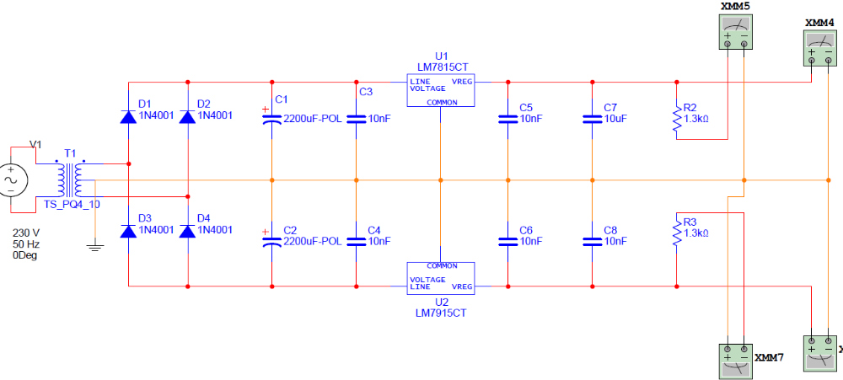
SPECIFICATIONS
Power supply:
Output Voltage: +15V DC
Transformer Output Voltage: 18-0-18V AC
Output Current: 1A AC
LVDT

Slide 8
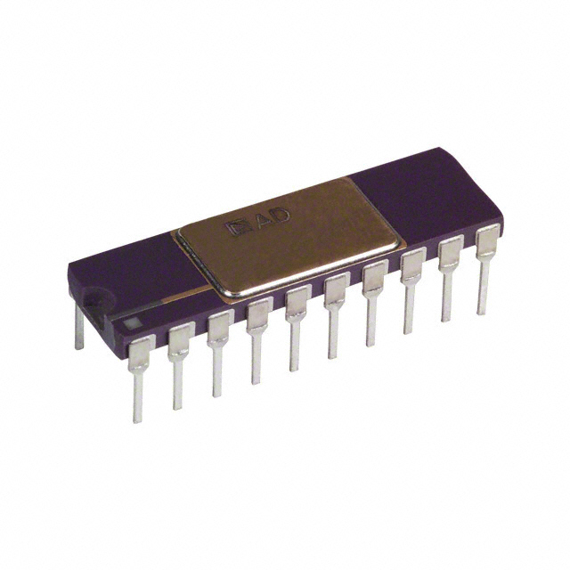
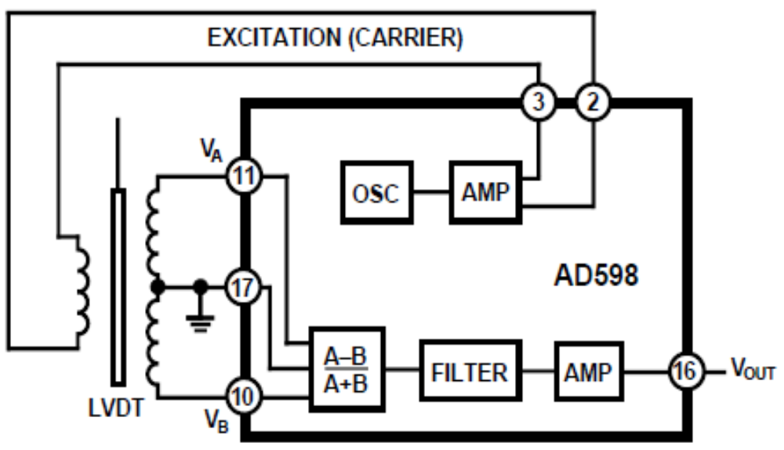
AD 598:
20 Hz to 20 KHz frequency range
DC Output proportional to Position
Input Voltage: +15V and 12mA
LVDT

Slide 9
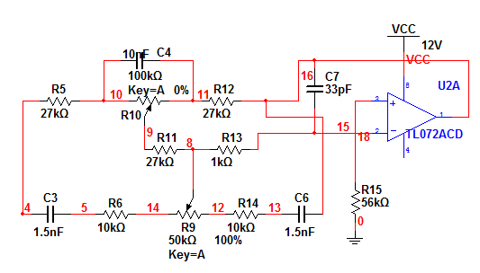
Tone control circuit:
Consider f1 and f2 as cut off frequencies. At frequencies lower than f1, all capacitors are open circuit.
LVDT

Slide 10
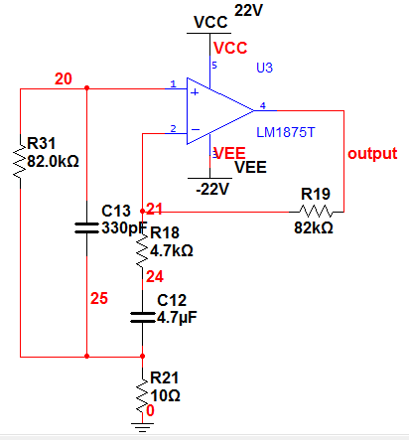
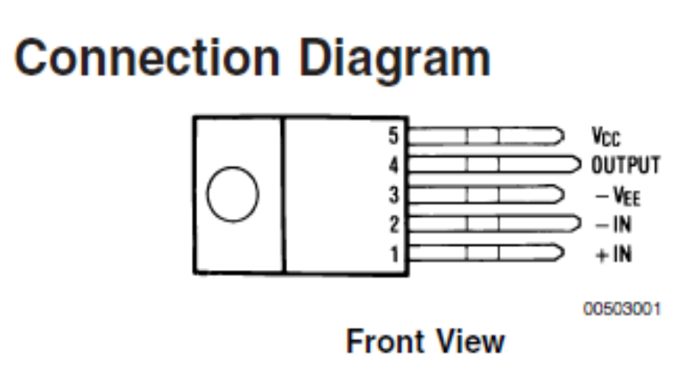
Audio Amplifier:
Gain: 18
Output Power: 10W (Max)
Power Supply : +22V
LVDT

Slide 11
Circuit diagram
LVDT

Slide 12
Simulation results
LVDT

Slide 13
LVDT

Slide 14
LVDT

Slide 15
LVDT

Slide 16
LVDT

Slide 17
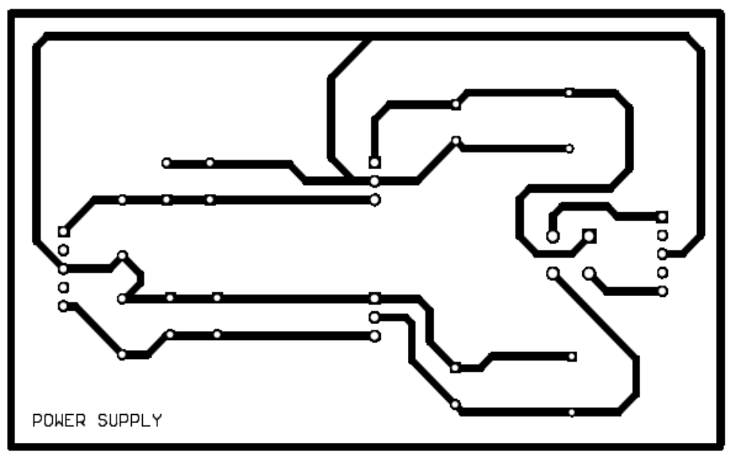
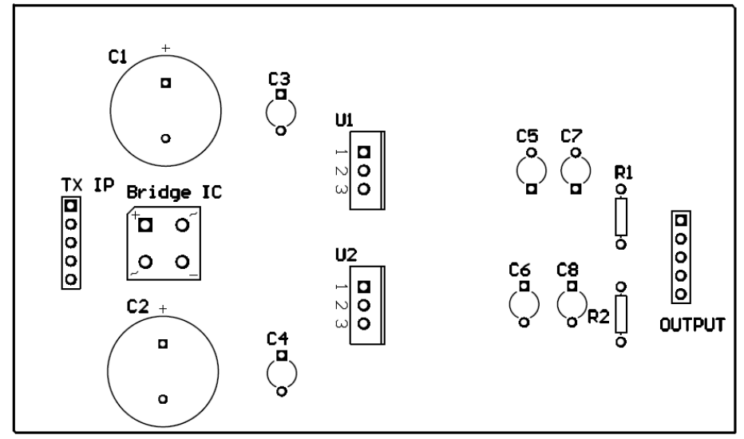
PCB LAYOUTS:
Power supply:-
Bottom:
Top OVERLAY:
LVDT

Slide 18
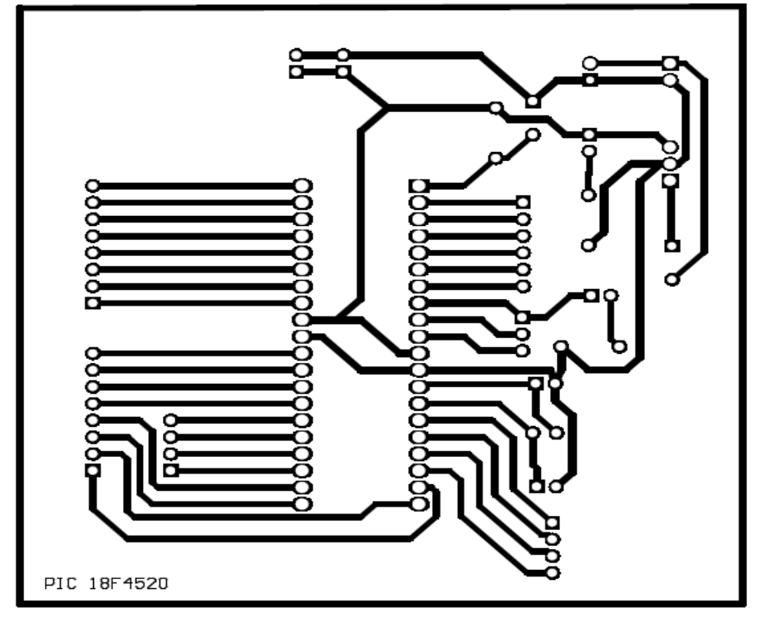
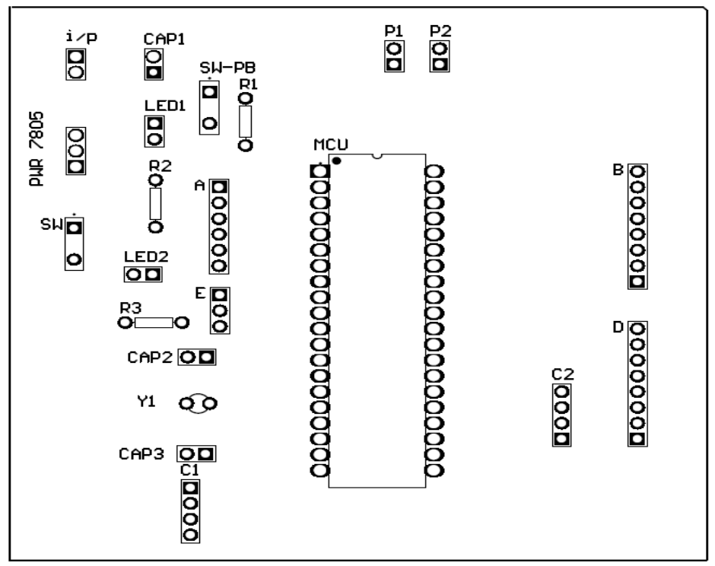
PIC microcontroller
BOTTOM:
Top OVERLAY:
LVDT

Slide 19
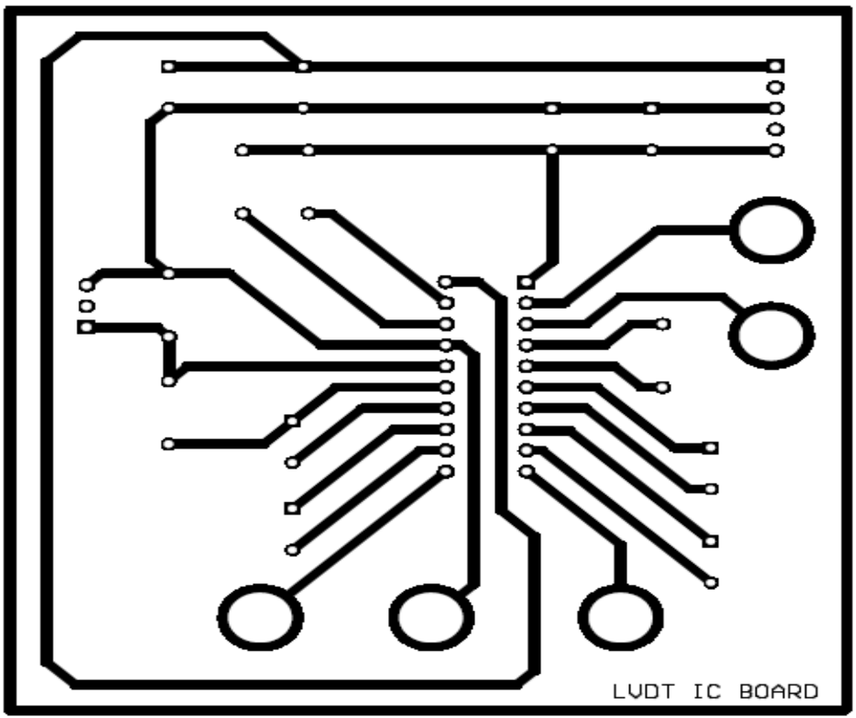
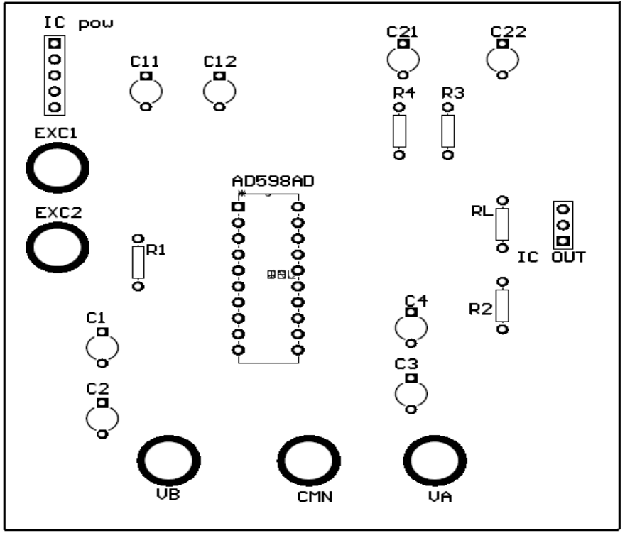
IC AD 598
BOTTOM:
Top OVERLAY:
LVDT

Slide 20
Cabinet design and assembly
The cabinet is an acrylic enclosure of dimensions 26*16 cm while the height being 8 cm.The acrylic sheet that we selected is a 3 mm thick sheet. The enclosure formation required cutting, drilling and using adhesives the box is made. The cabinet design requires utmost importance to be given for the spacing and the where to place each component. Apart from this it also requires dimensional analysis of each component.
Our Cabinet design specifications are as follows:
Length: 26 cm
Width: 16 cm
Height: 8 cm
Thickness of the acrylic sheet: 3mm
LVDT

Slide 21
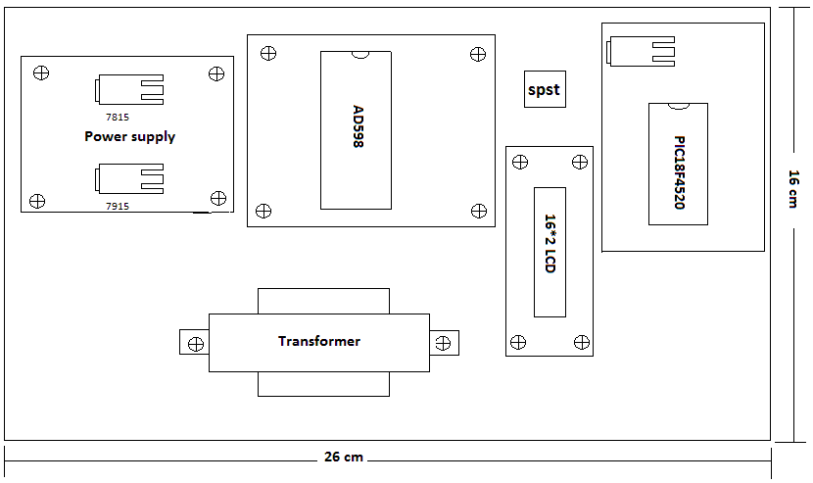
Cabinet Layout
LVDT

Slide 22
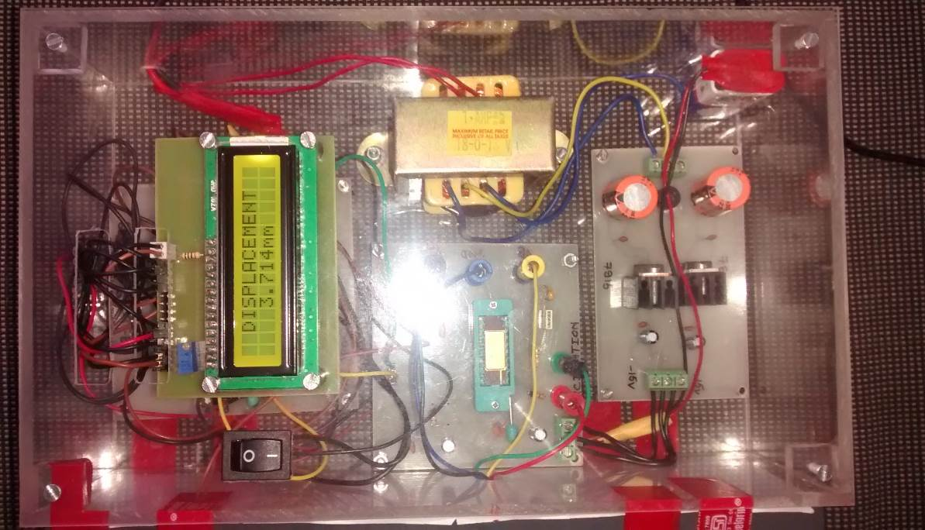
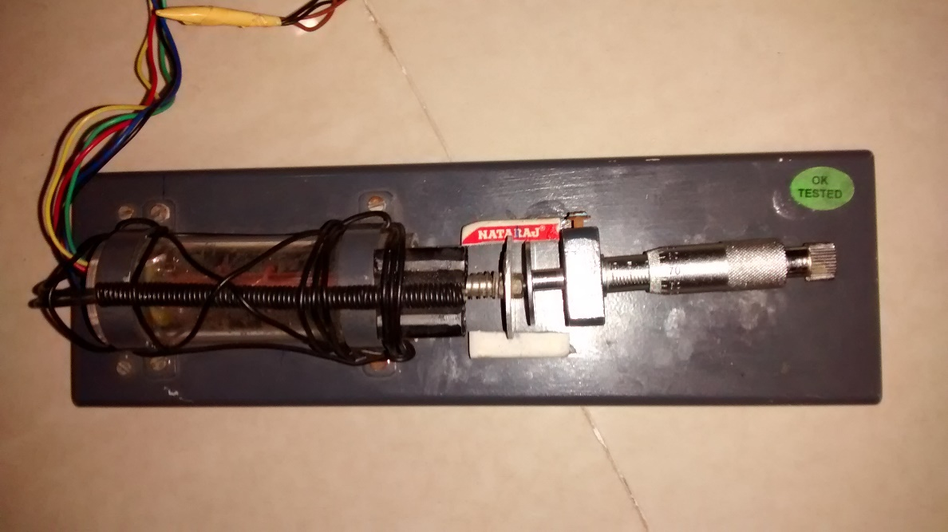
Cabinet
LVDT
LVDT

Slide 23
LVDT Linearity
LVDT

Slide 24
Thank You!
LVDT
Notes:
Stereo Amplifier

